Slide 1

Data Insights
Team: ZeroR
Pratik Shrestha (077BCT)
Nitiz Khanal (077BEL)
Team ZeroR

Slide 2


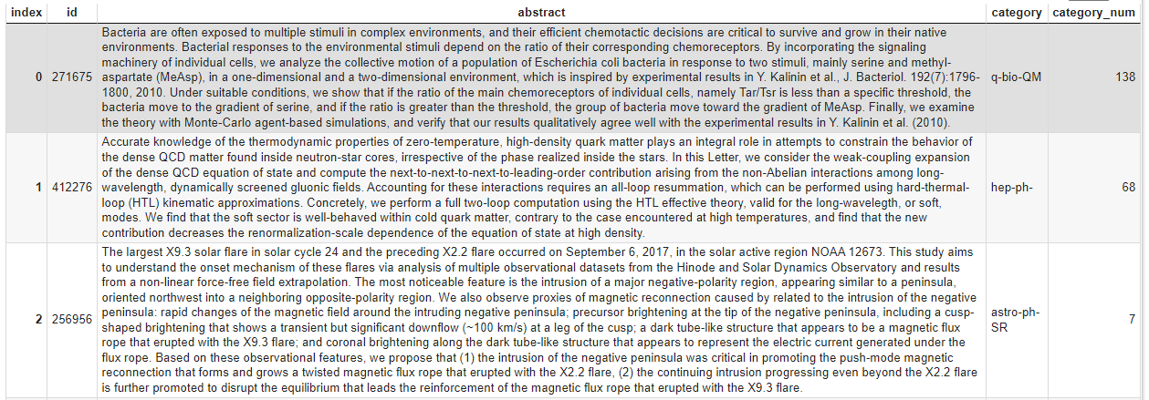
Data
Abstracts of papers from arXiv
My poor laptop

Slide 3
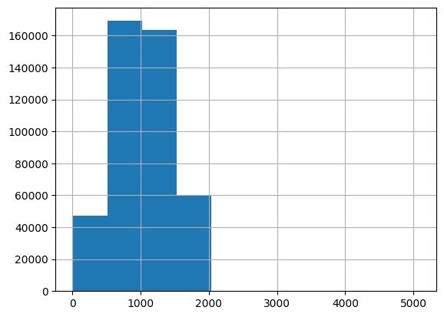
Characters
The number of characters in abstracts varies greatly, ranging highly from 500 to 1500.

Slide 4
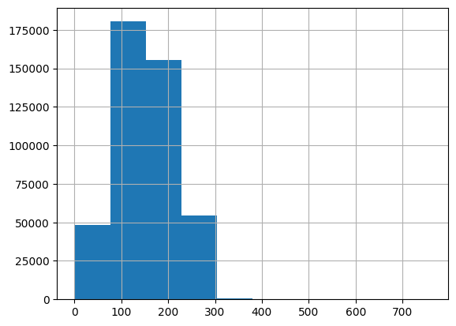
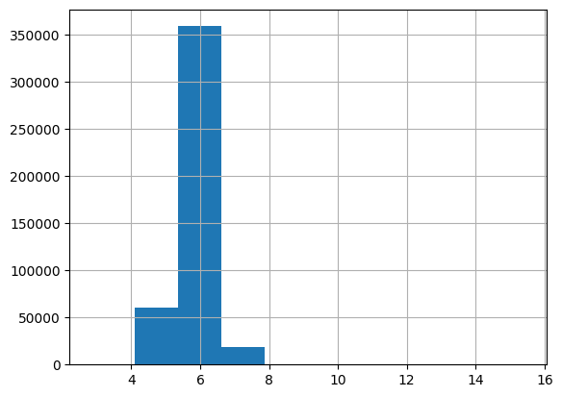
Words in abstracts
Words in sentences
Average Word length in sentences of abstracts
Average Word count in abstracts

Slide 5
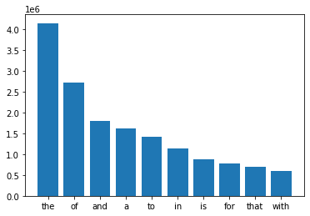
Most common Stop Words in abstracts

Slide 6
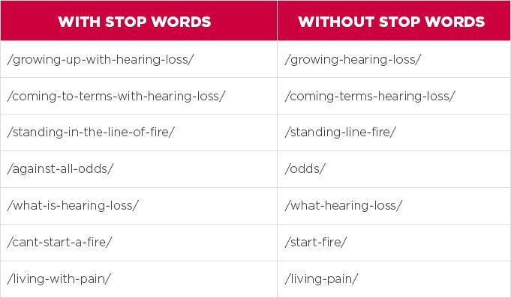
Removal of Stop Words

Slide 7
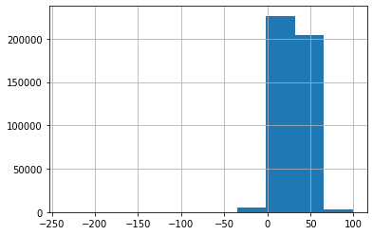
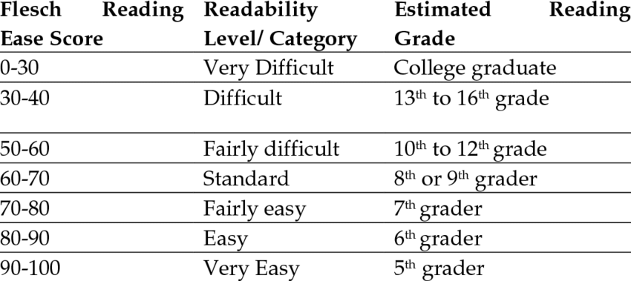
Abstracts Readability scores
Most of the abstracts lie on the “very difficult” and “difficult” range ie. people below the undergrad level would find them difficult to understand.

Slide 8
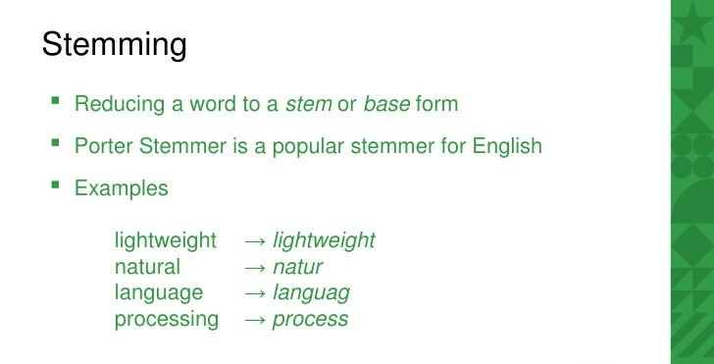
Text Preprocessing

Slide 9
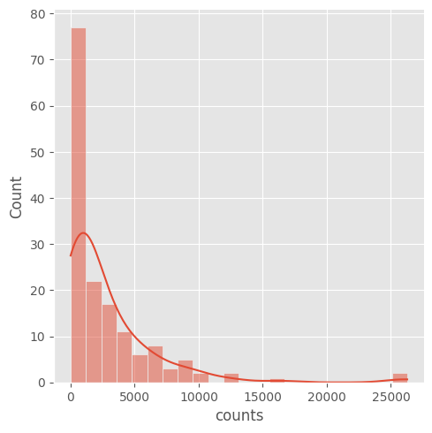
Distribution of Categories

Slide 10
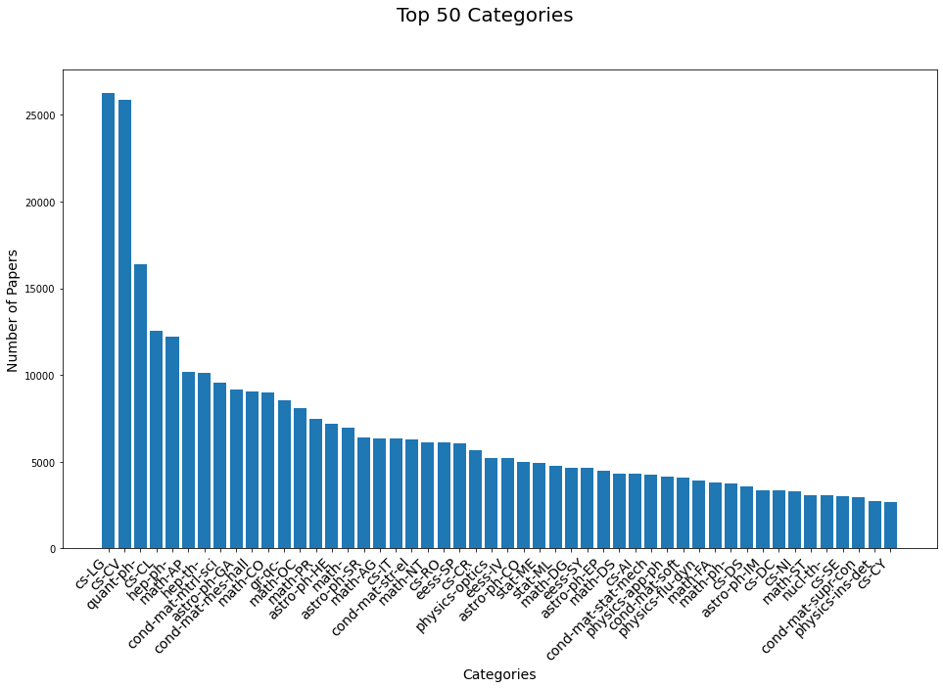

Slide 11
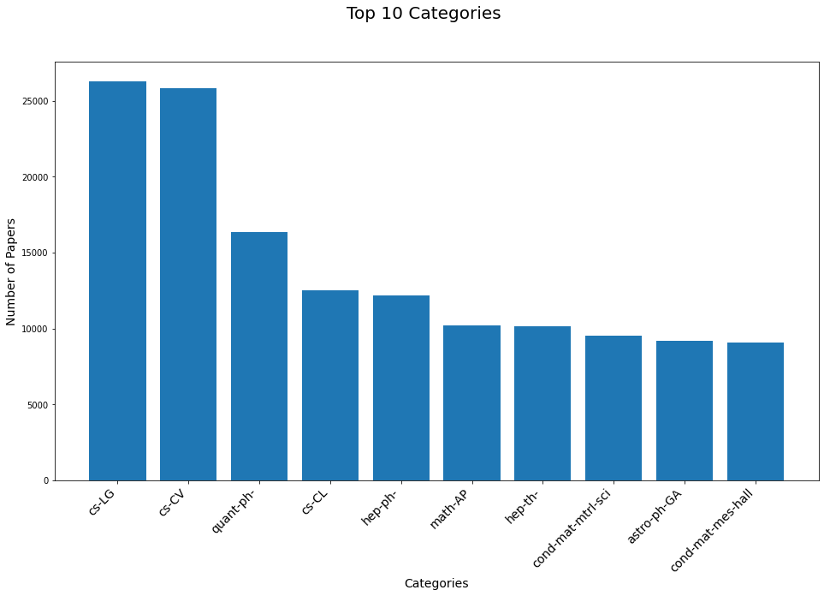

Slide 12
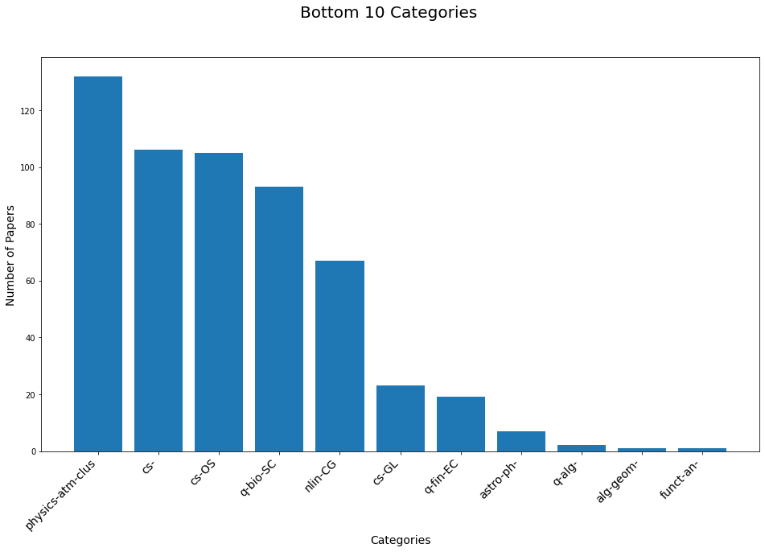
Class Imbalance; Hello, SMOTE.

Slide 13
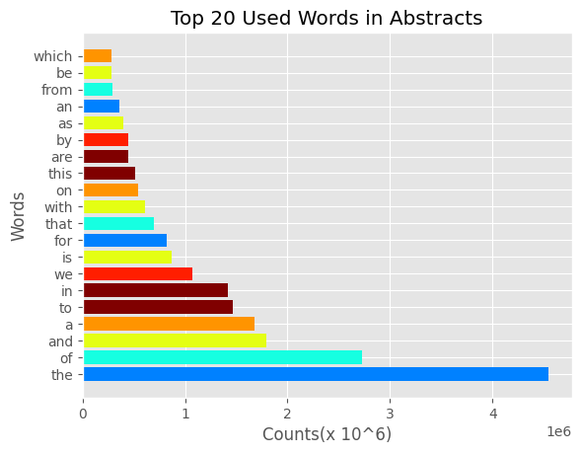
(Before cleaning Stop Words)

Slide 14
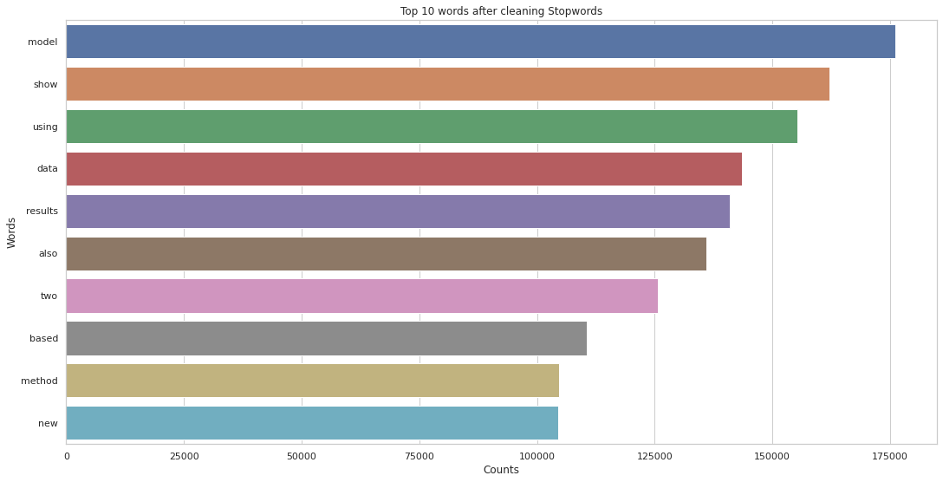

Slide 15
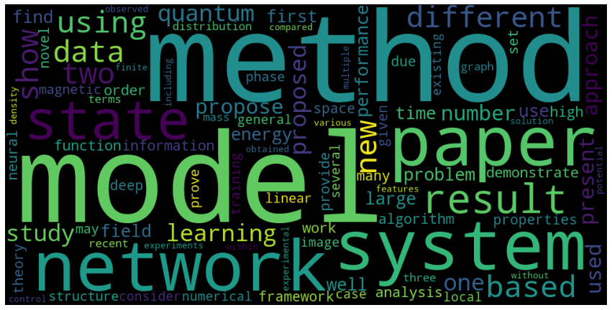
Most used words in abstracts.

Slide 16
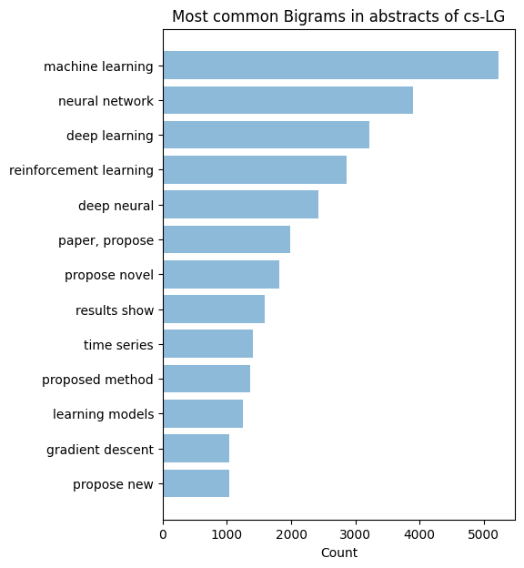
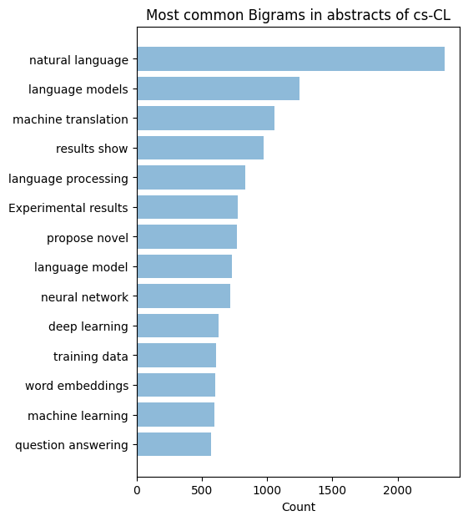
Neural Networks and Deep Learning dominate ML research.
Most popular NLP task: Machine Translation

Slide 17
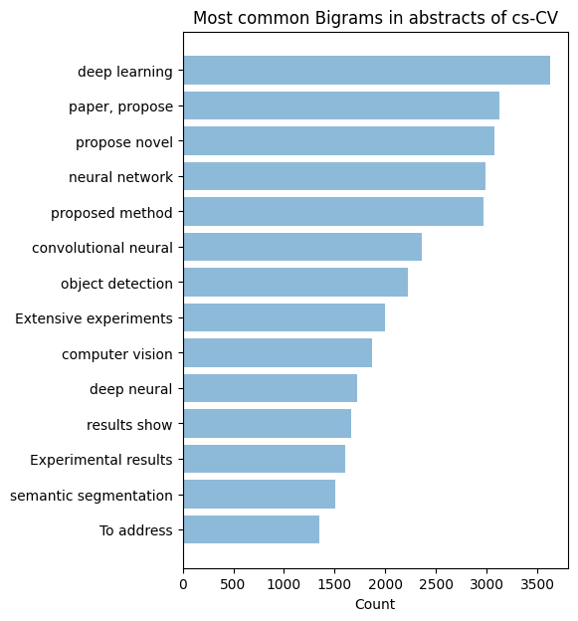
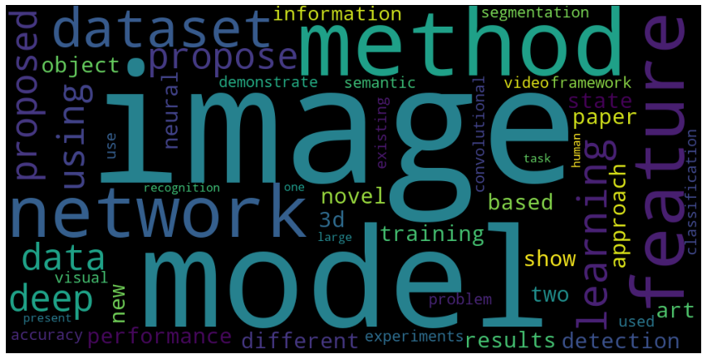
Most used words in the abstracts of category cs-CV
Dominance of Convolutional Nets on Computer Vision Tasks

Slide 18
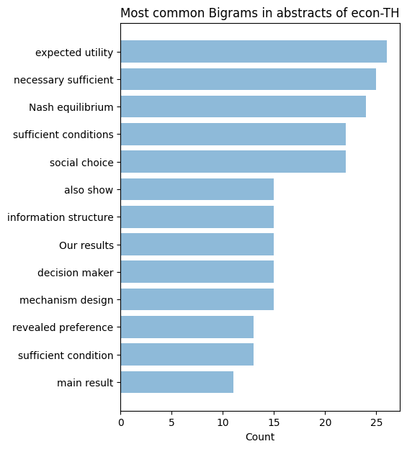
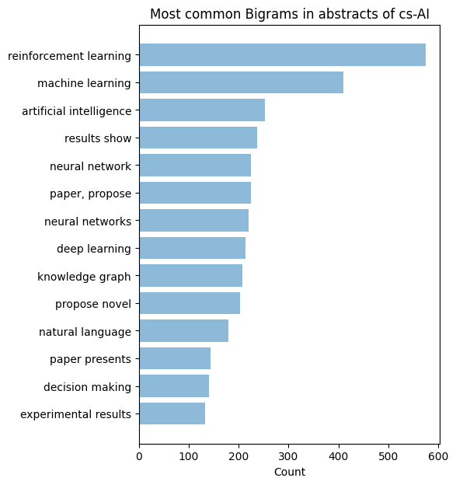
Mr.Nash is a mathematical genius.
Reinforcement Learning: The Buzz Word

Slide 19
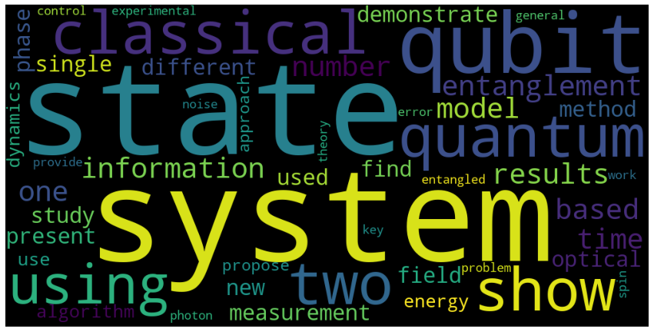
Most used words in the abstracts of category quant-ph-
Quite a lot of Quantum Computing Research

Slide 20
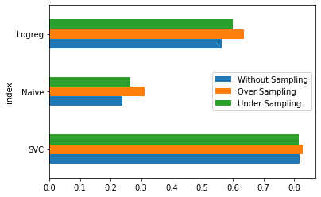
Models’ accuracy comparison

Slide 21

BERT, RandomForest, XGBoost, Transformers, Deep Neural Networks
Results:
A.K.A Poverty

Slide 22
Models Comparison Reasoning
Algorithms used in the variants of models.
Naive Bayes, Support Vector Machine, Logistic Regression, CNN-LSTM, LSTM
What caused the decrease/increase in accuracy ?
Deeper Neural Nets gave higher accuracy but failed to reach the test-set accuracy of Logistic Regression.
What might have improved your performance like training resources, time, etc ?
Definitely, More training resources.

Slide 23
Reference
The only resource you need:
0. https://tinyurl.com/2p8wmyrv

Slide 24
Thank You

